Slide 1
Chapter 12
Factors with forcats

Slide 2
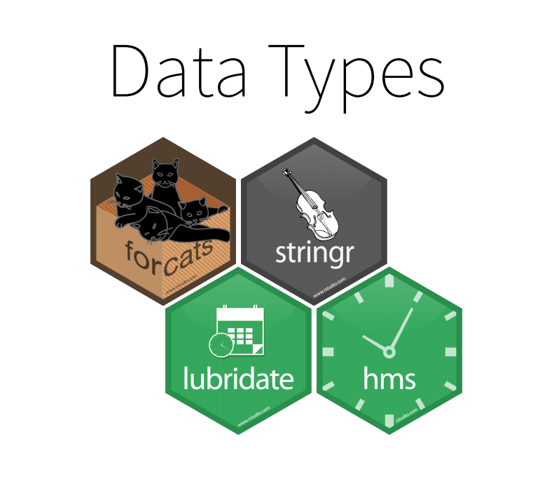

Slide 3
Key Findings
Factors-forcats
Modifying factor level/order
Better include n=n() for observation

Slide 4
Exercise
Pg227
1
Pg232
1
Pg 235
2

Slide 5
Chapter 13
Dates and Times with lubridate

Slide 6
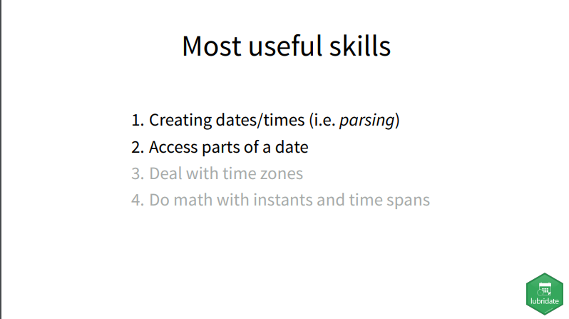

Slide 7
Lubridate
Work with date and times in R
Round Date-times
Floor_date-round down to nearest unit
Round_date-round to nearest unit
Ceiling_date-round up to nearest unit
Rollback-roll back to last day of previous month
Durations-physical time
Period-add human times
Interval-span of units

Slide 8
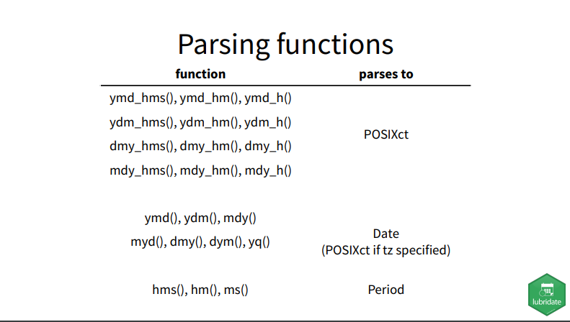

Slide 9
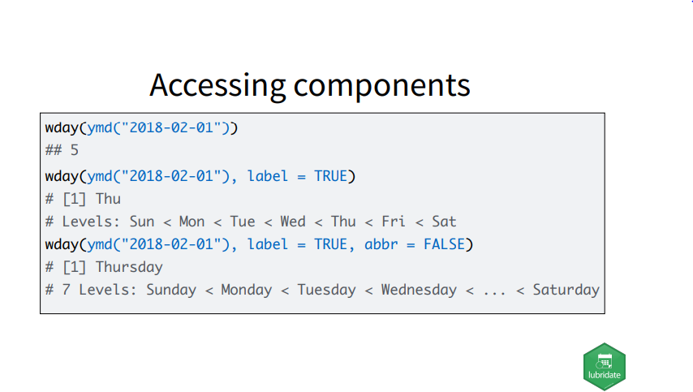

Slide 10
Exercise
For each of the following formats (of the same date), pick the right `ymd()` function to parse them:
"2018 Feb 01"
"2-1-18"
"01/02/2018“
Pg 254
4

Slide 11
Chapter 14
Pipes with magrittr

Slide 12
%>% read as ‘then’

Slide 13
Chapter 15
Functions

Slide 14
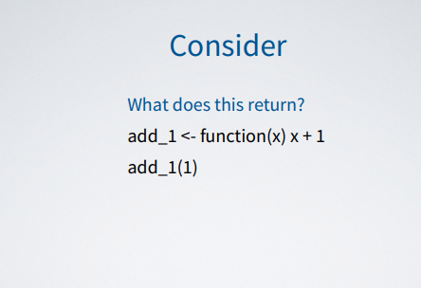
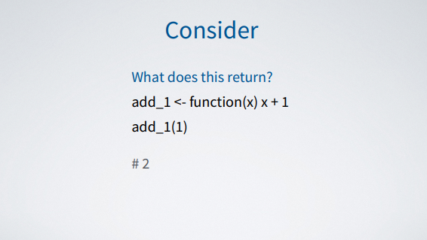

Slide 15
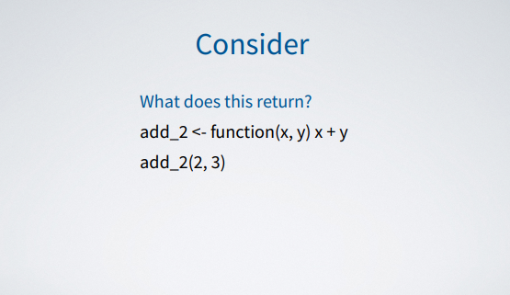
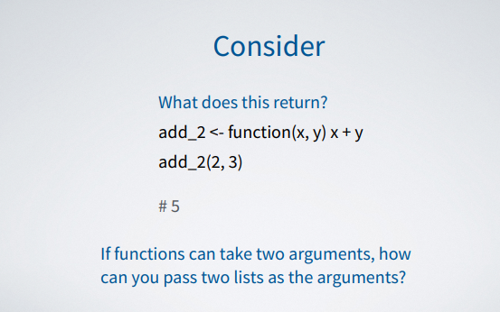

Slide 16
Exercise
Pg273
2,3,5,6,7
Pg276
1,3,4
Pg279
2,4,5,6
Pg 285
1-4

